Slide 1

DSA0216-Computer Vision with the OpenCV for Moderen AI
Vision based sign language recognisaiton using CNN
Supervised by
Dr. Senthilvadivu S
Dr. Kumaragurubaran T
Presented by
K .Deeksha Sree (192424097)
B. Karunyeswari(192424235)
Ch. .Sai Reshma (192424098)

Slide 2


ABSTRACT
Vision-based Sign Language Recognition using Convolutional Neural Networks (CNN) is a system that automatically identifies hand gestures from images or live video and converts them into text or speech. In this project, hand gesture images are captured using a camera and preprocessed by resizing and converting them into suitable formats. A CNN model is then trained to learn important features like edges, shapes, and patterns of different signs. The trained model classifies each gesture into its corresponding alphabet or word. This system helps bridge the communication gap between deaf-mute individuals and normal speakers by providing real-time and accurate sign recognition. It is cost-effective, user-friendly, and can be implemented using deep learning techniques for better performance.

Slide 3
OBJECTIVES
To develop a vision-based system that captures hand gestures using a camera and processes them for sign language recognition.
To design and implement a Convolutional Neural Network (CNN) model for extracting features and accurately classifying sign language gestures.
To improve recognition accuracy and performance by applying image preprocessing techniques such as resizing, normalization, and noise reduction.
To convert recognized sign gestures into readable text or speech, enabling effective communication between hearing-impaired and normal-hearing individuals.

Slide 4
PROBLEM STATEMENT
Communication Gap: Hearing-impaired individuals face difficulties communicating with people who do not understand sign language.
Lack of Real-Time Systems: Existing systems are not fully accurate, real-time, or easily accessible for daily use.
Manual Dependency: Communication often depends on human interpreters, which may not always be available.
Need for Automation: There is a need to develop a vision-based automated system using CNN to recognize sign language gestures and convert them into text or speech efficiently.

Slide 5
PROPOSED METHOD
Collect Gesture Images (Dataset)
↓
Preprocess Images
(Resize, Normalize)
↓
Build & Train CNN Model
(Convolution, Pooling, Dense)
↓
Capture Live Gesture (Webcam)
↓
Predict Gesture using CNN
↓
Display Text / Speech Output

Slide 6
Literature Review
Study / Year | Method Used | Advantages | Disadvantages
CNN-Based Sign Language Recognition (2023) | Convolutional Neural Network with preprocessing | Good accuracy for static hand gestures. Simple and easy to implement. | Limited to isolated signs. Sensitive to background noise.
CNN + LSTM Model (2024) | CNN for feature extraction and LSTM for sequence learning | Recognizes dynamic gestures. Captures temporal information effectively. | Requires large datasets. Higher computational complexity.
MobileNetV2-Based Model (2024) | Lightweight CNN using transfer learning | Suitable for real-time and mobile applications. Faster processing speed. | Slightly lower accuracy compared to deep models. Performance affected by lighting conditions.
3D-CNN Model (2025) | 3D Convolutional Neural Network for video-based recognition | Captures spatial and temporal features. | High memory usage. Needs powerful hardware and longer training time.

Slide 7

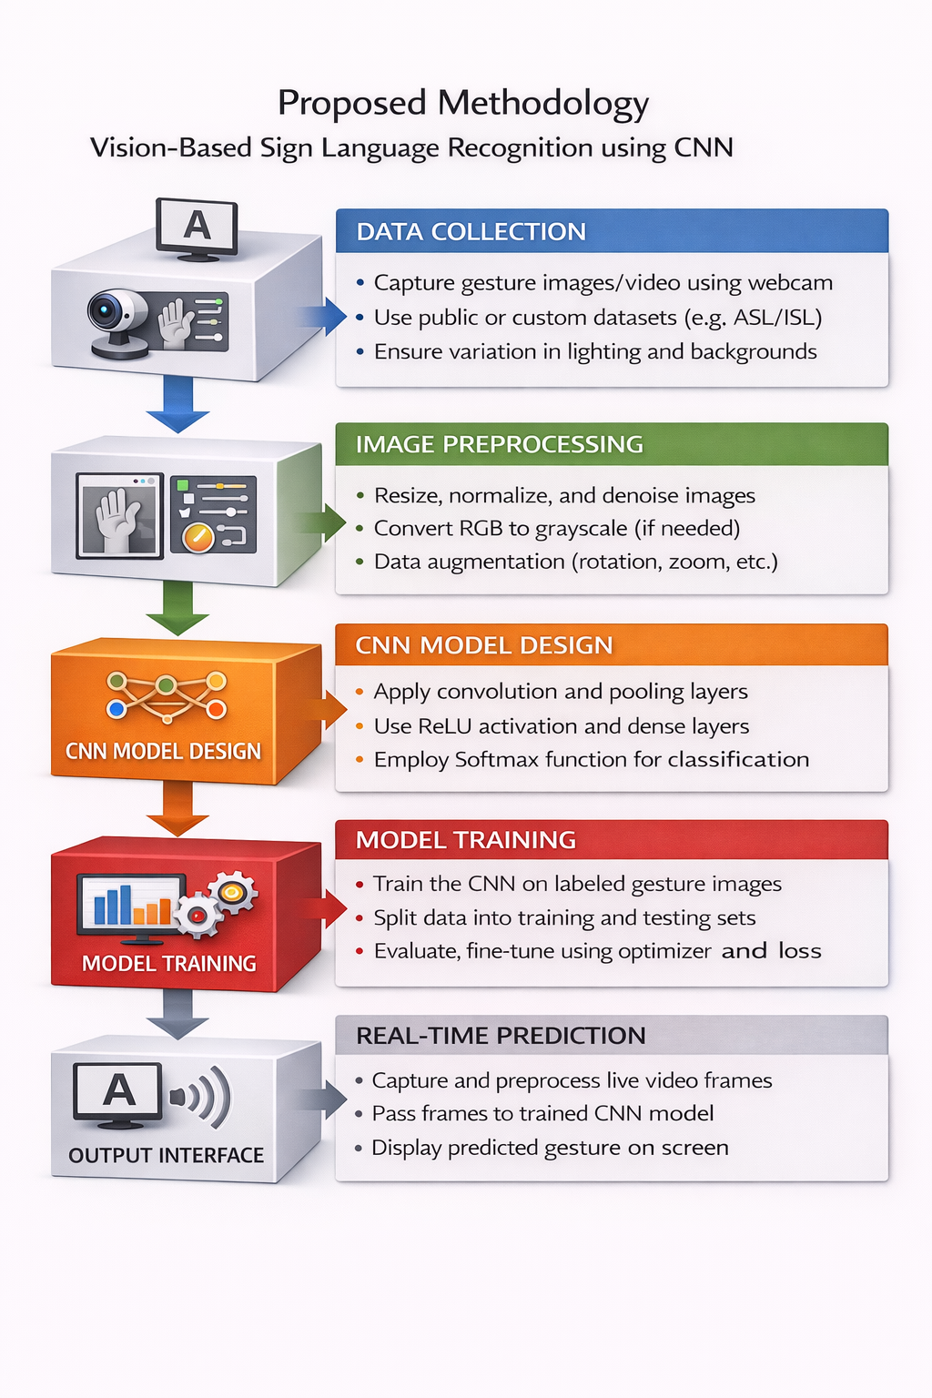
System Architecture

Slide 8
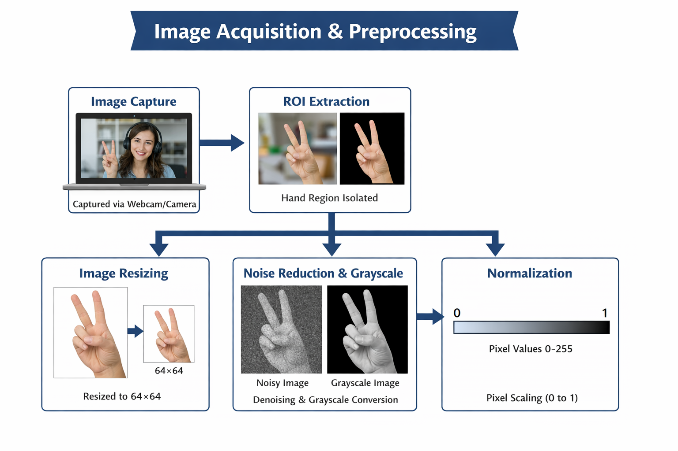
MODULE 1:Image Acquisition & Preprocessing
Image Capture: Hand gesture images are captured using a webcam or camera in real-time or from a stored dataset.
Region of Interest (ROI) Extraction: The hand region is detected and separated from the background for focused processing.
Image Resizing: Captured images are resized to a fixed size (e.g., 64×64 or 128×128) to ensure uniform input to the CNN model.
Noise Reduction & Gray scale Conversion: Noise is removed using filters, and images are converted to gray scale to reduce complexity.
Normalization: Pixel values are scaled (0–1 range) to improve CNN training efficiency and accuracy.

Slide 9
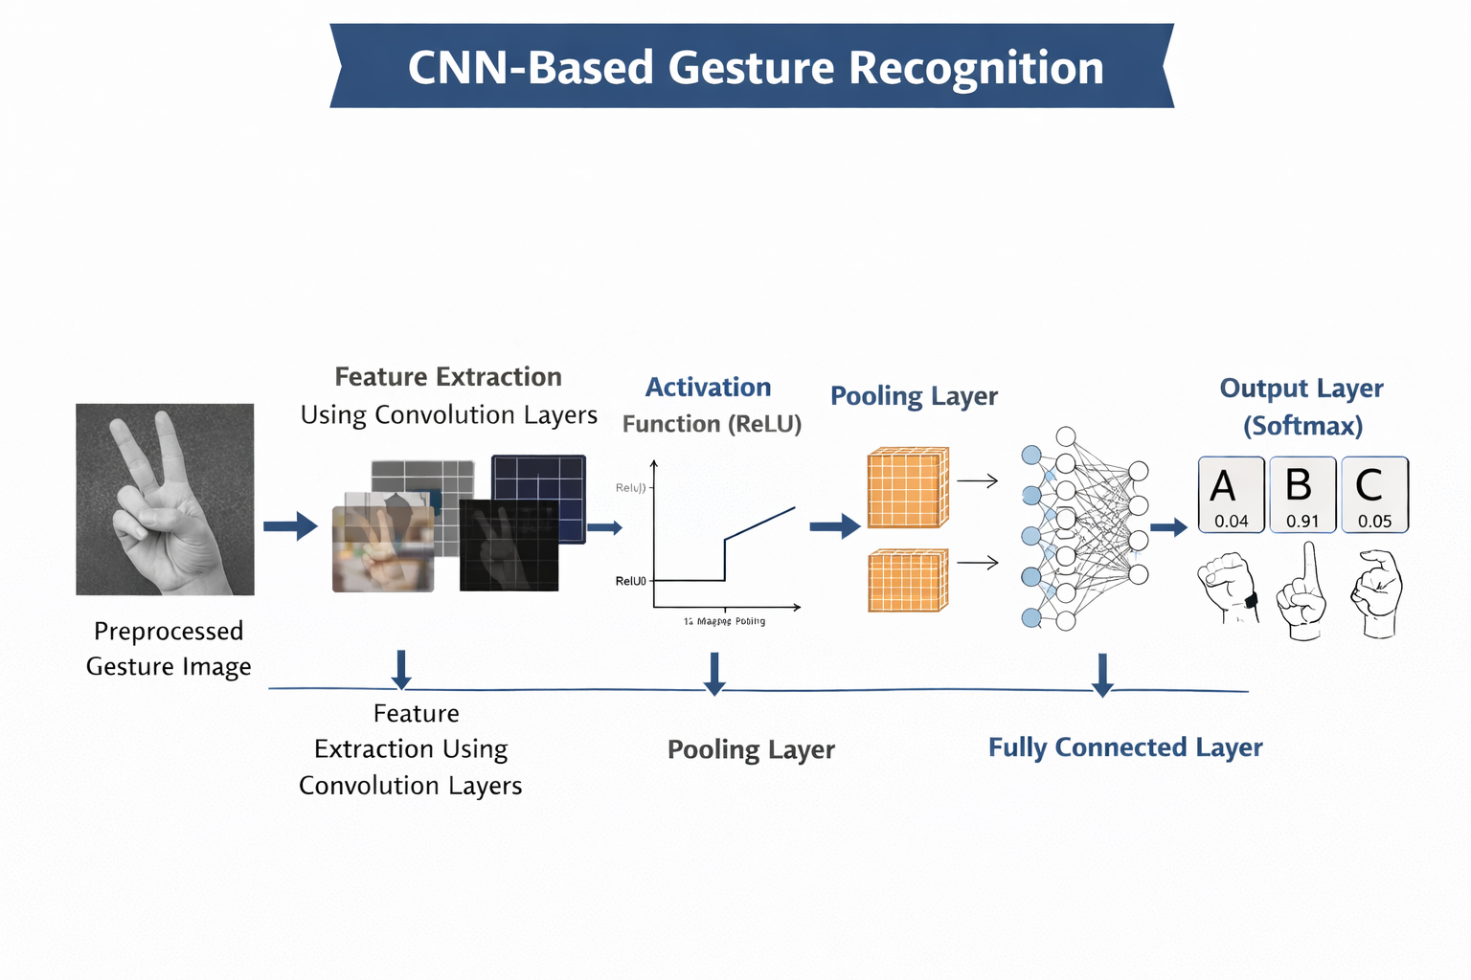
MODULE 2: CNN - Based Gesture Recognition
Feature Extraction using Convolution Layers: The CNN automatically extracts important features such as edges, shapes, and hand patterns from preprocessed gesture images.
Activation Function (ReLU): Non-linear activation functions like ReLU are applied to introduce non-linearity and improve learning capability.
Pooling Layer: Max pooling or average pooling reduces the image dimensions while retaining important features, reducing computation and over fitting.
Fully Connected Layer: The extracted features are flattened and passed to fully connected layers for classification of different sign gestures.
Output Layer (Softmax): The final layer predicts the gesture class (e.g., A, B, C, etc.) by assigning probability scores to each possible sign.

Slide 10
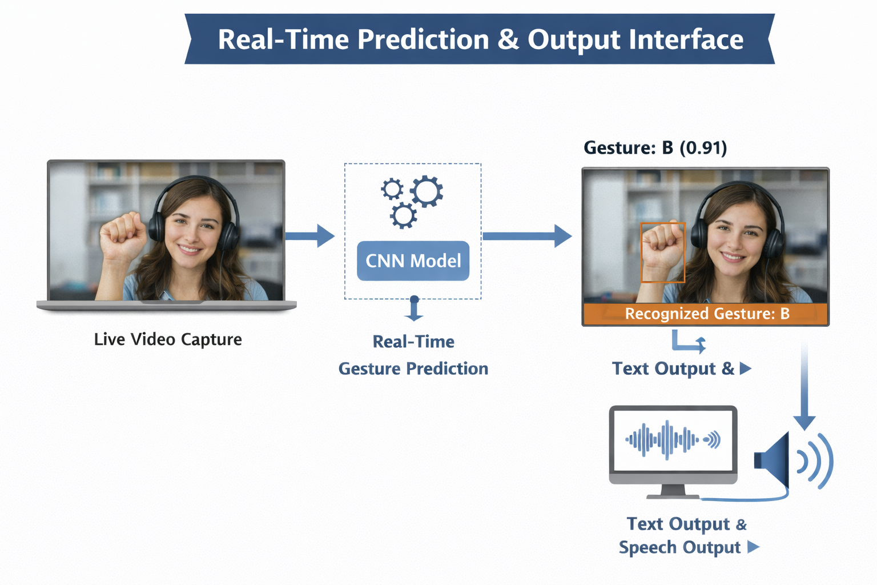
MODULE 3:Real - Time Prediction & Output Interface
Live Video Capture: The system continuously captures live video frames from a webcam for real-time gesture detection.
Real-Time Gesture Prediction: Each captured frame is processed and passed to the trained CNN model to instantly predict the hand gesture.
Confidence Score Display: The model outputs the predicted gesture along with probability/confidence scores.
Text Conversion: The recognized gesture is converted into readable text displayed on the screen.
Speech Output (Optional): The predicted text can be converted into audio using a text-to-speech system to enable smooth communication.

Slide 11
Conclusion
Effective Communication Tool: The system successfully reduces the communication gap between hearing-impaired individuals and non-sign language users.
High Accuracy with CNN: Convolutional Neural Networks effectively extract visual features from hand gestures, providing accurate classification results.
Real-Time Performance: With proper preprocessing and optimization, the system can perform real-time gesture recognition efficiently.
Scalability & Improvement Scope: The model can be further improved by using larger datasets, hybrid architectures (CNN + LSTM), and advanced preprocessing techniques.
Social Impact: This technology promotes inclusivity and accessibility by enabling smoother interaction and independence for the hearing-impaired community.

Slide 12
Future Scope
Continuous Sentence Recognition: Extend the system from recognizing isolated gestures to continuous sign language sentence translation.
Multilingual Sign Language Support: Expand the model to support multiple sign languages such as ISL, ASL, and other regional variations.
Mobile & Edge Deployment: Develop lightweight models that can run efficiently on smartphones and embedded devices for wider accessibility.
Integration with AI Assistants: Combine the system with chatbots or virtual assistants for real-time interactive communication.
Improved Accuracy with Advanced Models: Use advanced architectures like CNN + Transformer or attention-based models to enhance performance and robustness.

Slide 13
References
N. Sreekanth, P. Prachi & K. Sai Kirthana, Sign Language Recognition using Convolutional Neural Networks, Journal of Science & Technology, Vol. 8, No. 7, 2023.
G. D. Gayathri et al., Sign Language Recognition Using Convolutional Neural Network, International Journal of Intelligent Systems and Applications in Engineering, Vol. 12, No. 17s, 2024.
K. Madhurima & M. Maneesha, Sign Language Recognition using CNN and Hand Gesture Tracking, International Journal of Engineering Research and Science & Technology, 2025.
D. Kumari & R. S. Anand, Isolated Video-Based Sign Language Recognition Using a Hybrid CNN-LSTM Framework Based on Attention Mechanism, Electronics, 2024.
A sensing data and deep learning-based sign language recognition approach, Computers and Electrical Engineering, Vol. 118, Part A, 2024.

Slide 14


